Slide 1
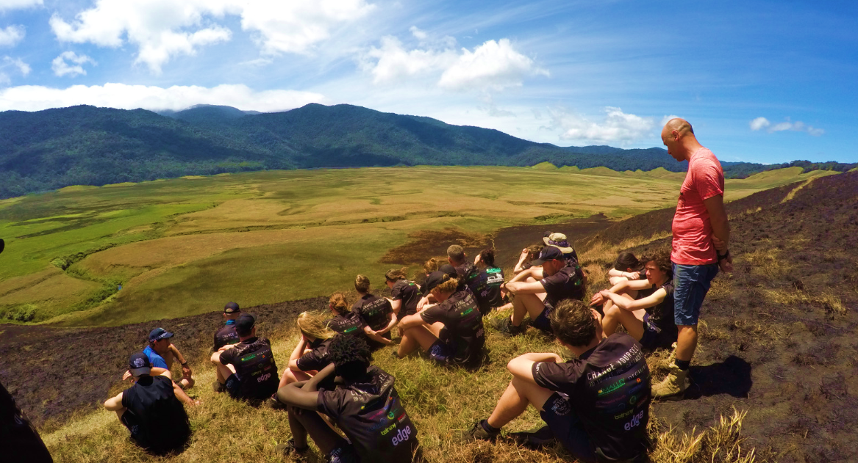



Geelong Youth Engagement would like to thank our supporters
Contact Us
E: info@gye.org.au
M: 0439 320 286
A: Suite 1, Level 1, 168- 170 Lt Malop Street, Geelong VIC 3220
ABN: 37 638 635 560
ACN: 638 635 560
September 2022

Slide 2



OUR SUCCESS
TARGET OUTCOMES
The success of the Geelong Kokoda Youth Program to date has shown that 85% of these young people have gone on to complete their high school education, with over 65% of these students furthering their education with university, TAFE, and apprenticeships.
The employment rate of the past participants is at 84%, with 36% in full time employment and 48% working part-time or casually (most of these currently studying or still at high school).
To date 127 young people have been involved with the program since 2013 and the planned numbers are to double this in the years ahead.
The intension of GYE is to grow and continue to develop more programs that target vulnerable young people from our community.
Reduce offending and anti-social behaviour
Reduce self-harm and possible suicide ideology
Promote positive interaction with local businesses and government agencies
Reduce the chances of young people becoming a victim
Break down barriers between police and young people, and reduce family violence matters
To empower positive community connections through a ‘Community web of protection’
Geelong Youth Engagement (GYE) is the umbrella organisation for the previous Victoria successfully running since 2013. Police facilitated youth programs including our flagship program Geelong Kokoda Youth Program which has been
GYE facilitate behavioural changes and empower youth to launch into successful adulthood and reach their potential.
HOW YOU CAN HELP
OUR FUTURE
Corporate Sponsorship - Your organisation can become a valued GYE sponsor and/or partner by making an annual or ongoing donation, by becoming a student sponsor for our Geelong Kokoda Youth Program, or contribute to the expansion of our future programs.
By involving staff members as adult mentors on our GKYP not only are you helping young people with support in the program, but staff members will also have great benefits .
Partnership - Geelong Youth Engagement are open to creating partnerships with other local organisations to combine our resources to promote and develop already existing and new programs for the youth of Geelong.
Community Support - We welcome all members of the community to contribute to our organisation and make a difference , all proceeds and in-kind support provided by community groups or individuals helps more young people from our region live up to their full potential.
Geelong Youth Engagement is registered as a charity with the ACNC and is endorsed for TCC & DGR.
OUR VISION
GYE want more young people of the Geelong region to benefit from the programs we offer. The future of Geelong Youth Engagement will see:
GKYP participants double – for 2022, there were be 2 programs ran simultaneously.
Currently GKYP benefit the young people from the state secondary schools, in 2022 we offered this program to the private secondary schools of Geelong and by 2023 we would like to develop a program in conjunction with AFL Barwon involving local sporting club
GYE would like to develop a resilience based program that can focus on suicide prevention and other risks identified for young people in our community, as well as supporting already developed programs with other local organisations.
To enhance outcomes for ‘at risk’ youth.
Encourage engagement with
- Education
- Employment
- Family
Increase youth confidence
Build Resilience
Create Engagement
Increase Self-Belief

